Slide 1




Recommendation Systems for Personalized Learning
Enhancing engagement & maximizing learning outcomes...
How this recommendation can transform education by delivering customised learning experiences, addressing key challenges and leverging cutting-edge technology.

Slide 2

Problems And Solutions
not getting individualized
attention
lack of engagement
struggle to find relavent
learning material
difficulty in tracking performance
and areas for improvement
AI-Powered personalize feedback and support
virtual tutors or chat box
peer to peer learning and collaboration
communication and interaction features
interactive and immersive content
gamification & reward and creative & engaging contents
virtual study groups and collaborative projects
choice and control over some extent
advanced search and filtering
intelligent tagging and categorization
personalized recommendation
pre-defined or personalized paths and curated collection
visualization and mind mapping
bookmarking and saving features
detailed progress dashboard
weekly performance report and analytics
goal setting and progress tracking
reflection and self assessment tools

Slide 3
How it works !!!!!
user profile creation
content analysis
“The system analyzes students interaction, learning preferences, and performance data to generate personalized recommendations, creating a dynamic and engaging learning experience.”
recommendation generation
feedback & adjustment
progress tracking & reporting

Slide 4



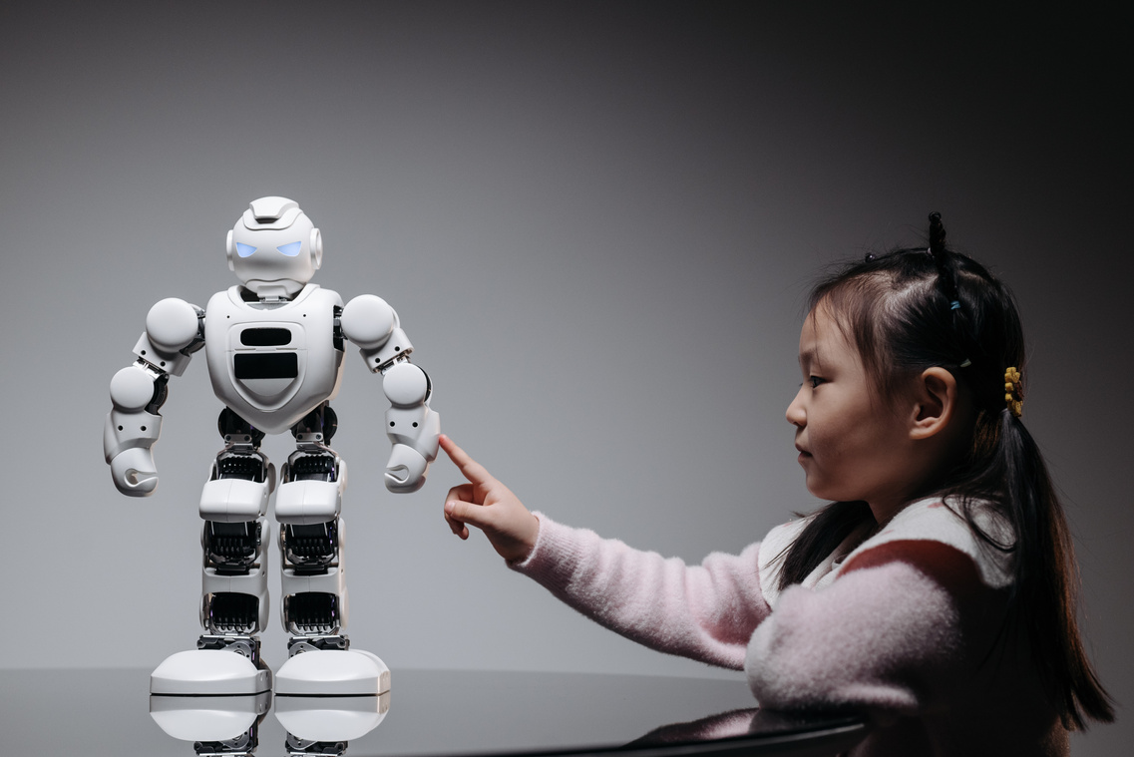


TECH STACK
FRONTEND
BACKEND
DATABASE
React and Vue.js for a responsive user interface
phython(Flask/
Dango) for API
PostgreSQL or MongoDB
MACHINE LEARNING
CLOUD
GAMIFICAT-ION
AWS OR GCP
Sckrit-lrarn or PyTorch
XP system

Slide 5
THANK YOU!!1
~Kankshi Patle
~24005043

